Slide 1
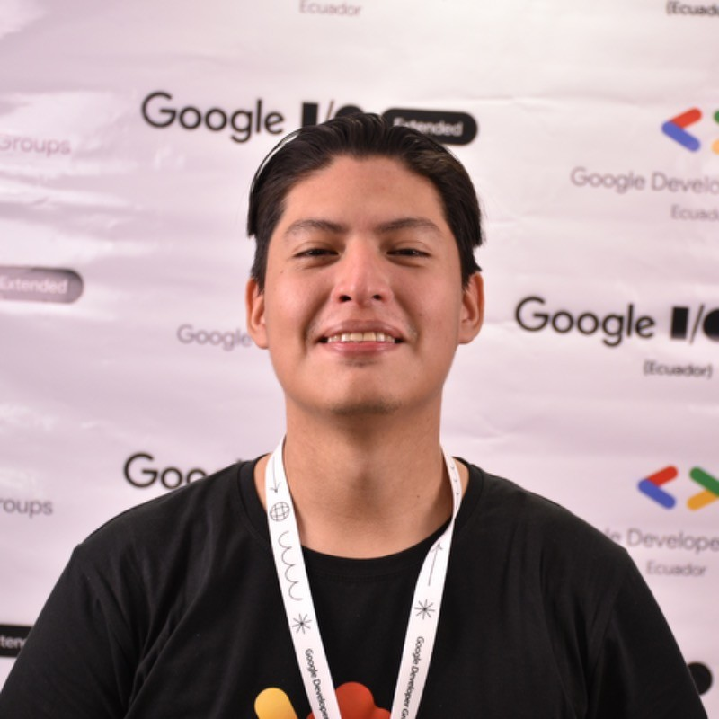
Carlos Loja Software Developer — Cloud & Product
Email
carlos.loja@thebridge.com
Location
Guayaquil, Ecuador
Mobile
+593 (99) 035-8359
Carlos joined The Bridge in May 2023. As a Full Stack Developer and Community Leader, he has developed React features for a logistics product and built Next.js web apps for a Web3 company. Carlos also volunteers, mentoring individuals entering the tech sector.
EXPERIENCE
Industry Experience
Last Mile Logistics | eHealth | University Security | Web3 | Technology
Web3 Apps in Next Js | Web3 Technology
FullStack developer for the creation of 3 web applications where users can register actions, add wallets, perform tasks, etc.
First application: Built with Next.js and Golang backend, enabling users to become blockchain validators, track actions, and receive rewards.
Second application: Also, in Next.js and Golang, it visualizes user actions from the first app and displays blockchain blocks.
Third application: Built in Next.js and Golang, it supports tasks for points/prizes, QR code scanning, entry self-validation, and integrates Instagram posts.”
On-Campus Security Flutter App | University Security
Mobile developer for the creation of a security application on university campus, with the objective of generating alerts immediately through a centralized system.
Development of usability tests.
Creation and evaluation of scenarios to determine the fault tolerance of the application.
Micro Frontend | Last Mile Logistics
Fullstack developer for the creation of a new microfrontend in charge of the logic for managing prices for a shipping route.
Development of functionality for creating a formula dynamically using drag and drop to incorporate new entries into the formulas with their respective operations.
Backend fixes for route price management logic.
Code refactoring in the frontend to incorporate new price management in routes.
BACKGROUND
Functional Skills
Frontend Engineer, Web Developer, React Developer, Flutter Developer, Fullstack Developer, Tech Strategy, Agile Project Management
Qualifications
Frontend Developer and Community Leader, Carlos has worked on the development of new features in React for the product of a last mile logistics company. Additionally, he has created new web applications with Next.js for a company focused on Web3 technology. In addition, Carlos actively participates in working with communities on a voluntary basis, providing them with guides to enter the world of technology.

Slide 2

Email
carlos.loja@thebridge.com
Location
Guayaquil, Ecuador
Mobile
+593 (99) 035-8359
Carlos joined The Bridge in May 2023. As a Full Stack Developer and Community Leader, he has developed React features for a logistics product and built Next.js web apps for a Web3 company. Carlos also volunteers, mentoring individuals entering the tech sector.
Carlos Loja Software Developer
Cloud & Product

